Slide 1
COVID-19 and conflict
Haakon Gjerløw
IMPACT OF THE PANDEMIC ON MEASURING PROGRESS OF SDG 16+: LOOKING FORWARD, TACKLING OBSTACLES
Side event of the SDG 16 Data Initiative, in the margins of the
2021 High-Level Political Forum
Monday, 12 July 2021 – 7:30am-9:00am (NYC Time)

Slide 2
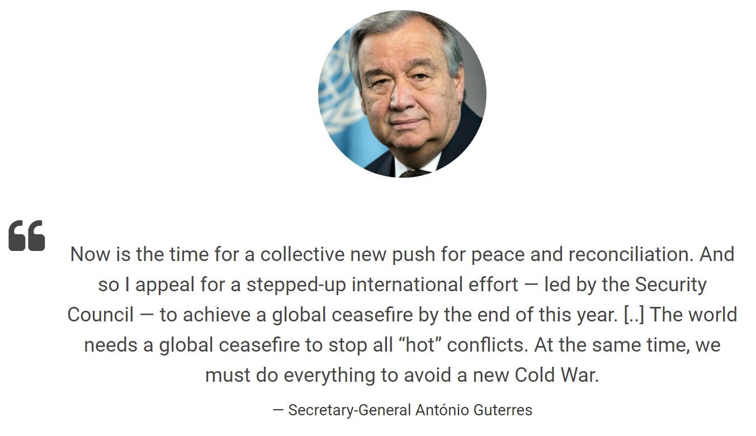

Slide 3
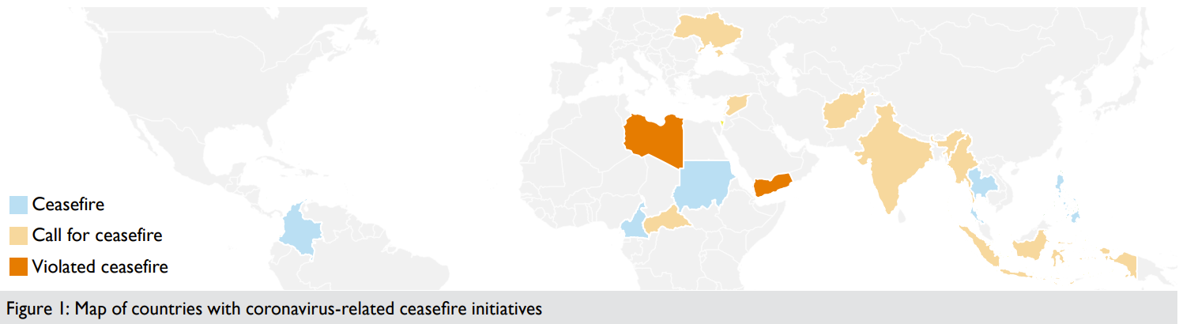
Coronavirus related ceasefires
Source: Rustad, Siri Aas; Håvard Mokleiv Nygård & Fredrik Methi (2020) Are the Coronavirus Ceasefires Working?, Conflict Trends, 4. Oslo: PRIO.

Slide 4
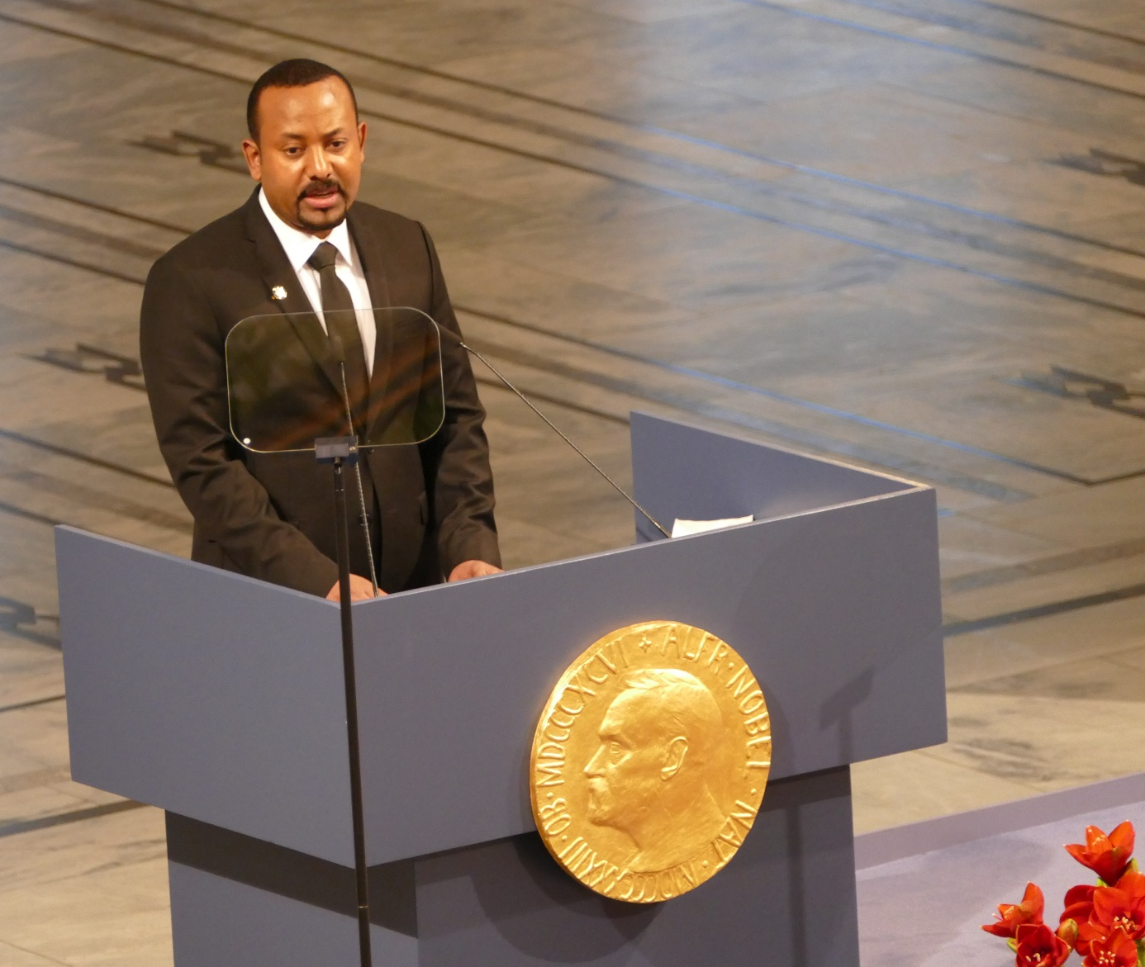
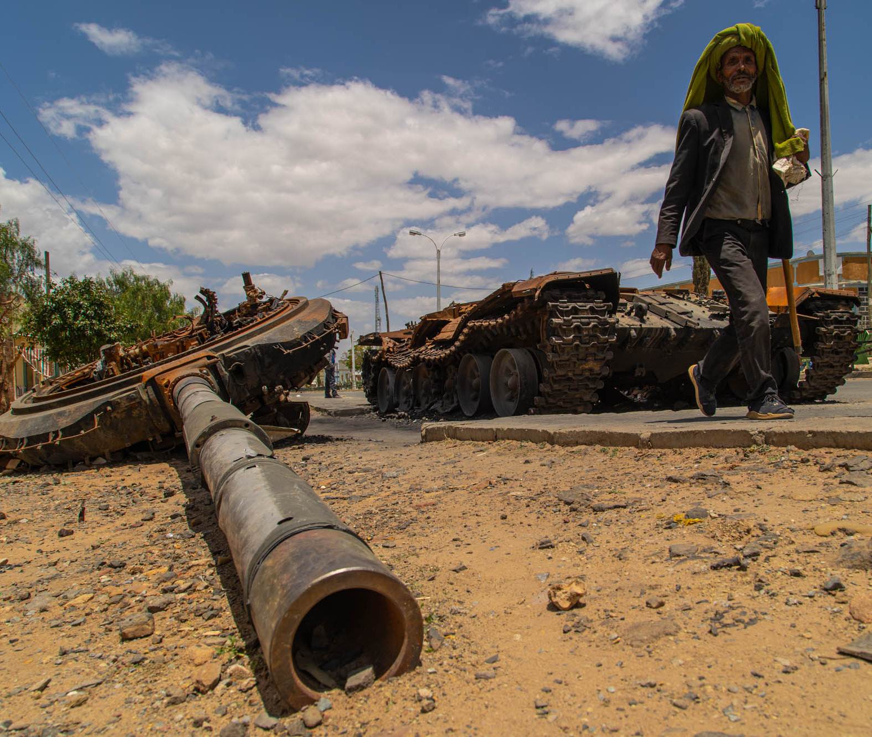
Old conflicts reemerged

Slide 5
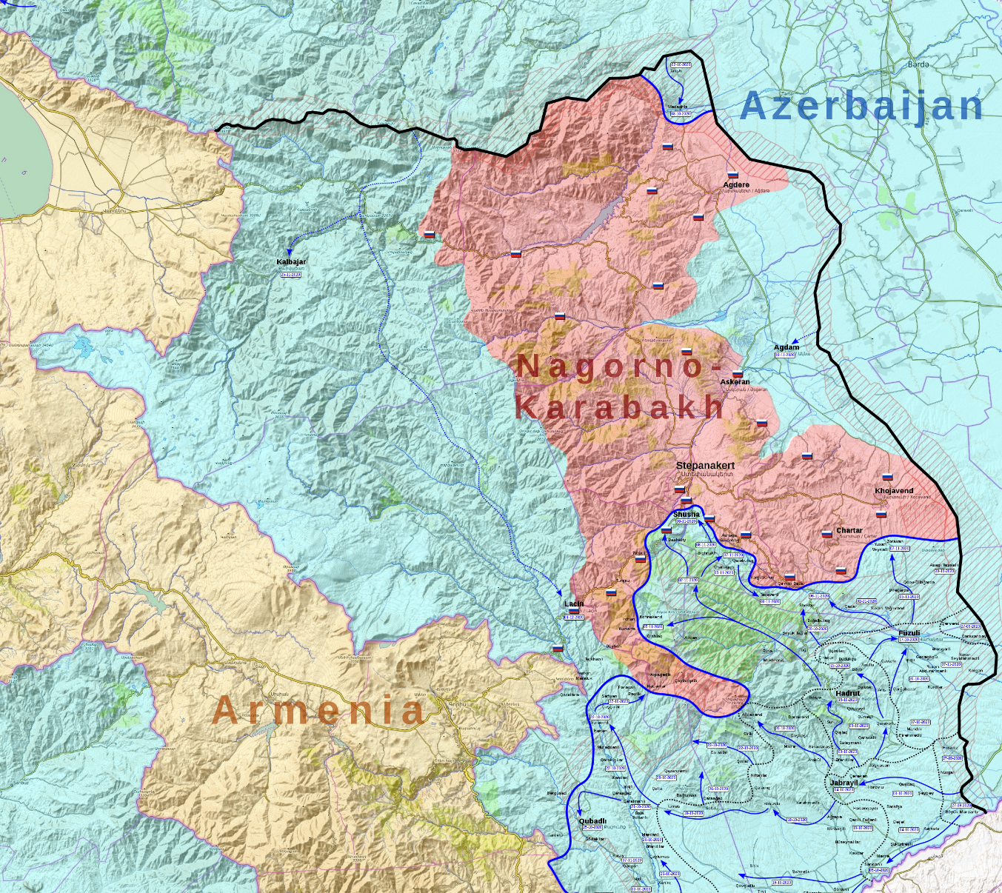
Old conflicts reemerged

Slide 6
Overall trends

Slide 7
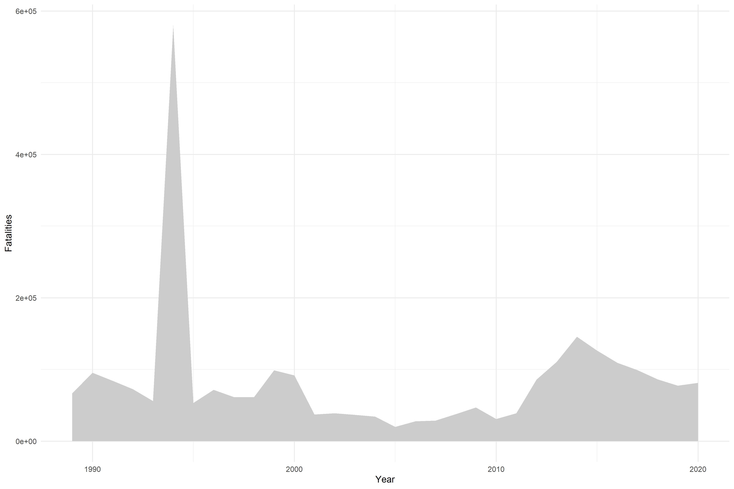
Overall trends: Battle deaths

Slide 8
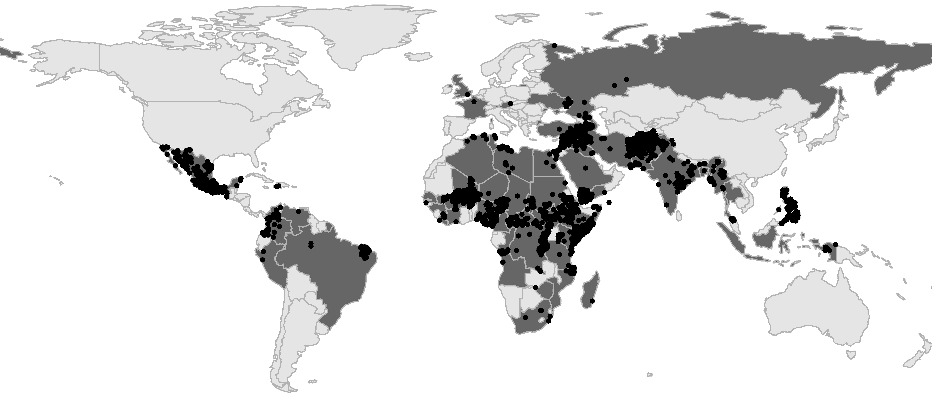
Overall trends: Conflict location

Slide 9
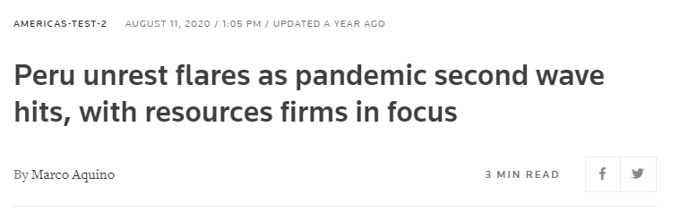
Covid, conflict and data collection

Slide 10
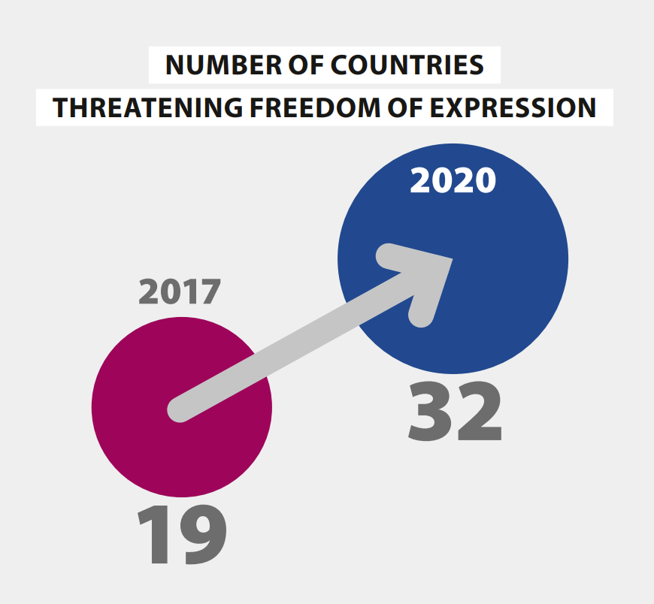
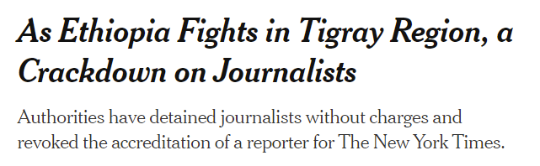
Covid, conflict and data collection
Source: Alizada et al. (2021) “Autocratization Turns Viral” Democracy Report 2021. University of Gothenburg: V-Dem Institute

Slide 11
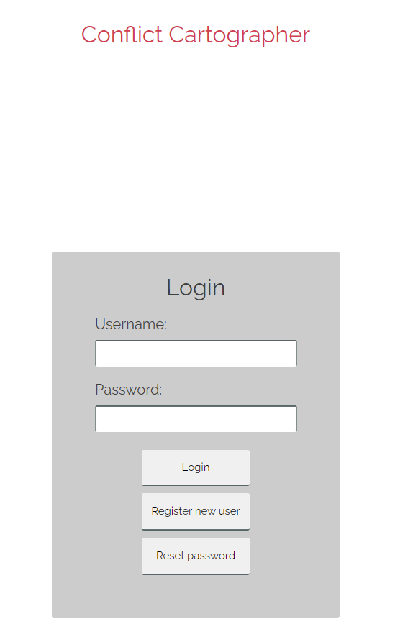
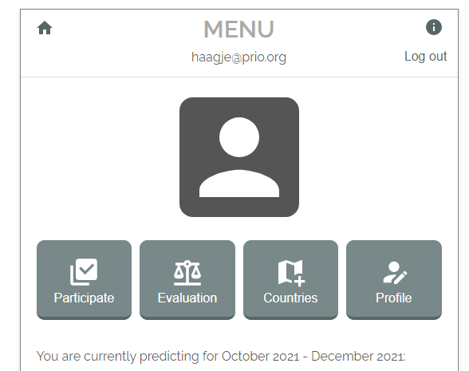
Innovations in data collection

Slide 12
Key recommendations
Independent media and Civil society
Peacekeeping operations

