Slide 1


The Global State of Democracy 2020
@Int_IDEA
@malaraotaola
www.idea.int

Slide 2
”Democracy as Development: Using the GSoD to measure SDG 16 progress”
Aims:
GSoD Indices to support measurement of SDG16
  As a complement / relevant during a pandemic
Specifically 16.3, 16.5, 16.6 and 16.7

Slide 3

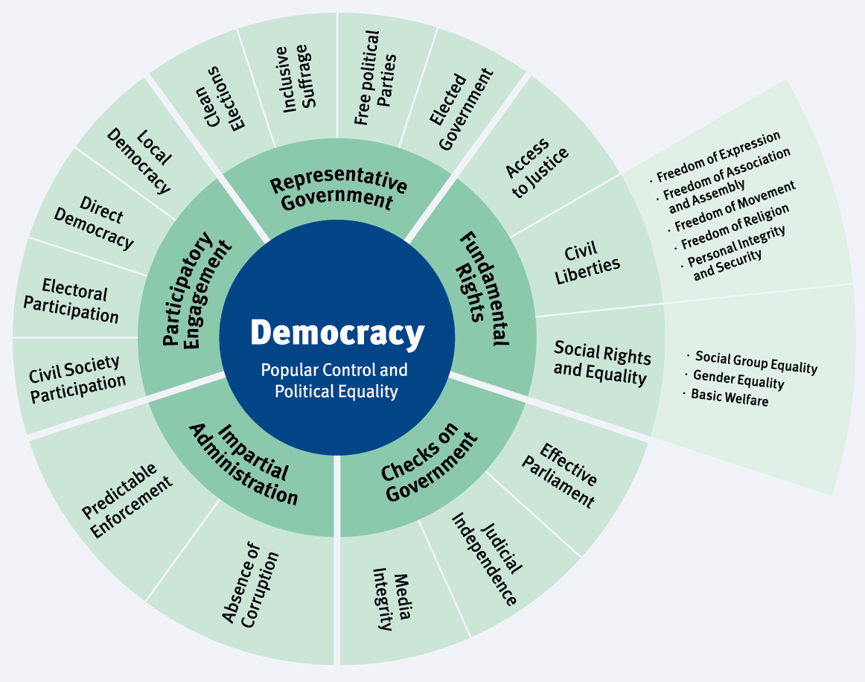
Democracy for Development
Before moving into specifics, a reflection on the importance of the GSoD Indices for the measurement of the SDGs
GSoD indices – measure the quality of democracy worldwide.
How do we measure this? 116 indicators, 166 countries, 1975-2020
Notes:
popular control over-decision-making and political equality in the exercise of that control
These principles have then be translated into 5 core attributes of democracy, which are the large circles that you see, and which IDEA believes are key elements of healthy democracies:
Representative Government (which focuses on free and fair elections and free political parties), Fundamental Rights, informal and formal checks on Government, Impartial administration, which includes absence of corruption and 5) participatory engagement, which focuses on citizen participation through civil society engagement and in national and local elections
Each attribute is assigned a score from 0 to 1, with 1 being the highest performance
The indices cover 163 countries across the world from 1975 to 2019 and are updated yearly. 2020 data
Based on the indices, we have developed a political regime classification, which is new to this report
We have identified 3 broad regime types: democracies, hybrid regimes and authoritarian regimes

Slide 4
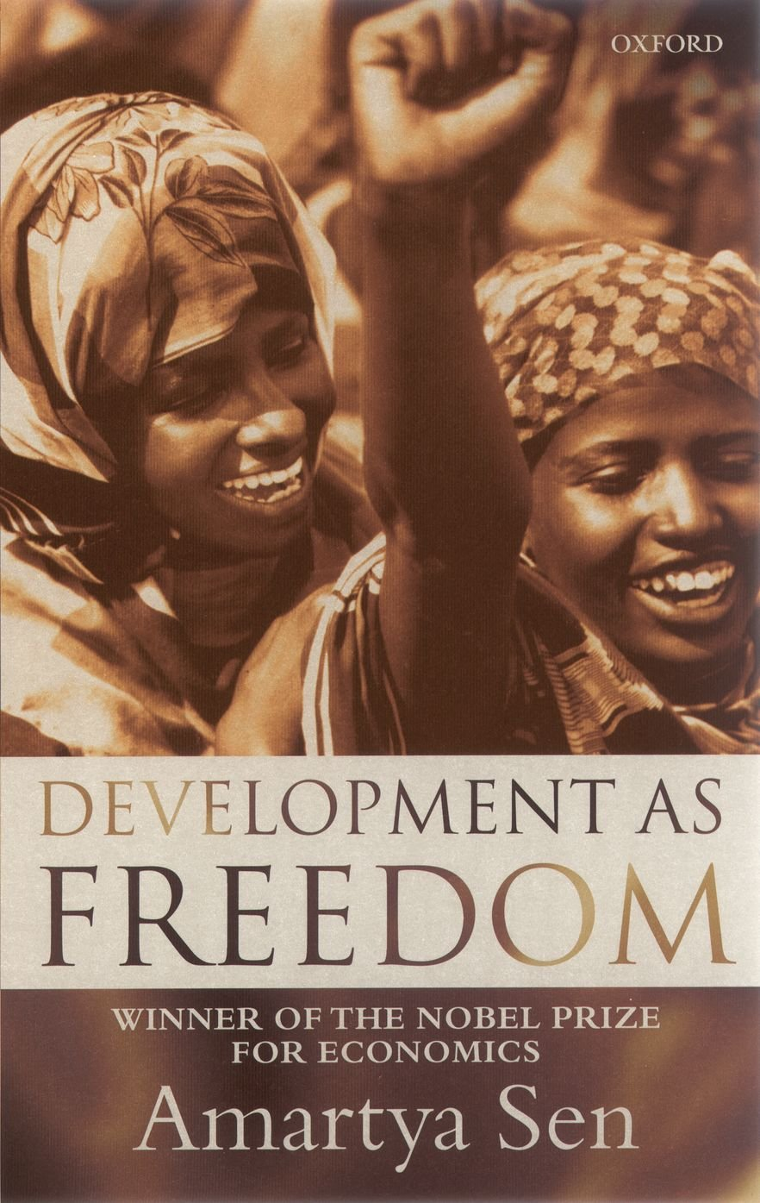
Democracy for Development
So, GSoD indices measure democracy. Why is this important?
Democracy is an enabler of sustainable development
Democracy is intrinsically & instrumentally important for development.
Intrinsic value
  Fundamental rights -freedom of expression, association, vote, lead lives.
Instrumental value “no famines”
Crisis: Write to MP, protests, elections, media..
Key mechanisms to express and demand public action
Powerful incentives to deliver
Therefore, it is not only important for SDG16 but for other achieving other goals.
Notes:
popular control over-decision-making and political equality in the exercise of that control
These principles have then be translated into 5 core attributes of democracy, which are the large circles that you see, and which IDEA believes are key elements of healthy democracies:
Representative Government (which focuses on free and fair elections and free political parties), Fundamental Rights, informal and formal checks on Government, Impartial administration, which includes absence of corruption and 5) participatory engagement, which focuses on citizen participation through civil society engagement and in national and local elections
Each attribute is assigned a score from 0 to 1, with 1 being the highest performance
The indices cover 163 countries across the world from 1975 to 2019 and are updated yearly. 2020 data
Based on the indices, we have developed a political regime classification, which is new to this report
We have identified 3 broad regime types: democracies, hybrid regimes and authoritarian regimes

Slide 5
GSoD indices: 16.3, 16.5, 16.6 & 16.7
Focus on 4 SDG16 targets:
16.3 Promote the rule of law and ensuring equal access to justice for all
16.5 Substantially reduce corruption and bribery in all their forms
16.6 Develop effective, accountable and transparent institutions
16.7 Ensure responsive, inclusive, participatory and representative decision-making at all levels
Amongst the 10 SDG16 targets, these four are directly relevant to the rules and institutions (the regime type) needed to achieve sustainable development.
Notes:
popular control over-decision-making and political equality in the exercise of that control
These principles have then be translated into 5 core attributes of democracy, which are the large circles that you see, and which IDEA believes are key elements of healthy democracies:
Representative Government (which focuses on free and fair elections and free political parties), Fundamental Rights, informal and formal checks on Government, Impartial administration, which includes absence of corruption and 5) participatory engagement, which focuses on citizen participation through civil society engagement and in national and local elections
Each attribute is assigned a score from 0 to 1, with 1 being the highest performance
The indices cover 163 countries across the world from 1975 to 2019 and are updated yearly. 2020 data
Based on the indices, we have developed a political regime classification, which is new to this report
We have identified 3 broad regime types: democracies, hybrid regimes and authoritarian regimes

Slide 6
16.3 Rule of law and equal access to justice
3 indicators:
Indicator 16.3.1 Proportion of victims of violence
Indicator 16.3.2 Unsentenced detainees as a proportion of overall prison population
Indicator 16.3.3 Proportion of the population who have experienced a dispute in the past two years and who accessed a formal or informal dispute resolution mechanism
2 GSoD sub attributes:
Access to justice
  5 indicators: access to justice for men, access to justice for women, judicial corruption decision, judicial accountability, and fair trial.
Judicial independence
  6 indicators: high court independence, lower court independence, compliance with high court rulings, compliance with the judiciary, law and order (strength and impartiality of the legal system and popular observance of the law), and independent judiciary.
Notes:
popular control over-decision-making and political equality in the exercise of that control
These principles have then be translated into 5 core attributes of democracy, which are the large circles that you see, and which IDEA believes are key elements of healthy democracies:
Representative Government (which focuses on free and fair elections and free political parties), Fundamental Rights, informal and formal checks on Government, Impartial administration, which includes absence of corruption and 5) participatory engagement, which focuses on citizen participation through civil society engagement and in national and local elections
Each attribute is assigned a score from 0 to 1, with 1 being the highest performance
The indices cover 163 countries across the world from 1975 to 2019 and are updated yearly. 2020 data
Based on the indices, we have developed a political regime classification, which is new to this report
We have identified 3 broad regime types: democracies, hybrid regimes and authoritarian regimes

Slide 7
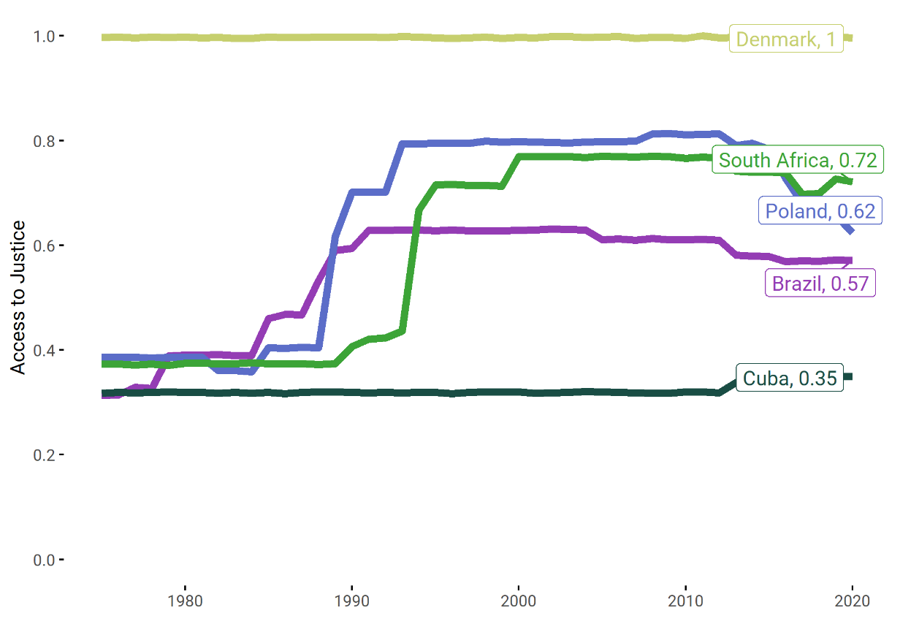
16.3 Rule of law and equal access to justice
Access to Justice in selected countries, 1975-2020
Notes:
popular control over-decision-making and political equality in the exercise of that control
These principles have then be translated into 5 core attributes of democracy, which are the large circles that you see, and which IDEA believes are key elements of healthy democracies:
Representative Government (which focuses on free and fair elections and free political parties), Fundamental Rights, informal and formal checks on Government, Impartial administration, which includes absence of corruption and 5) participatory engagement, which focuses on citizen participation through civil society engagement and in national and local elections
Each attribute is assigned a score from 0 to 1, with 1 being the highest performance
The indices cover 163 countries across the world from 1975 to 2019 and are updated yearly. 2020 data
Based on the indices, we have developed a political regime classification, which is new to this report
We have identified 3 broad regime types: democracies, hybrid regimes and authoritarian regimes

Slide 8
16.5 Corruption and bribery
2 indicators:
Indicator 16.5.1 Proportion of persons who paid a bribe to a public official, or were asked for a bribe by public officials
Indicator 16.5.2 Proportion of businesses that paid a bribe to a public official, or were asked for a bribe by public officials
1 GSoD sub attribute:
Absence of Corruption
5 indicators: public sector corrupt exchanges; public sector theft (asking how often public sector employees steal, embezzle or misappropriate public funds); executive embezzlement and theft; executive bribery and corrupt exchanges; and corruption (actual and potential in the form of patronage, favours, nepotism, etc)
Notes:
popular control over-decision-making and political equality in the exercise of that control
These principles have then be translated into 5 core attributes of democracy, which are the large circles that you see, and which IDEA believes are key elements of healthy democracies:
Representative Government (which focuses on free and fair elections and free political parties), Fundamental Rights, informal and formal checks on Government, Impartial administration, which includes absence of corruption and 5) participatory engagement, which focuses on citizen participation through civil society engagement and in national and local elections
Each attribute is assigned a score from 0 to 1, with 1 being the highest performance
The indices cover 163 countries across the world from 1975 to 2019 and are updated yearly. 2020 data
Based on the indices, we have developed a political regime classification, which is new to this report
We have identified 3 broad regime types: democracies, hybrid regimes and authoritarian regimes

Slide 9
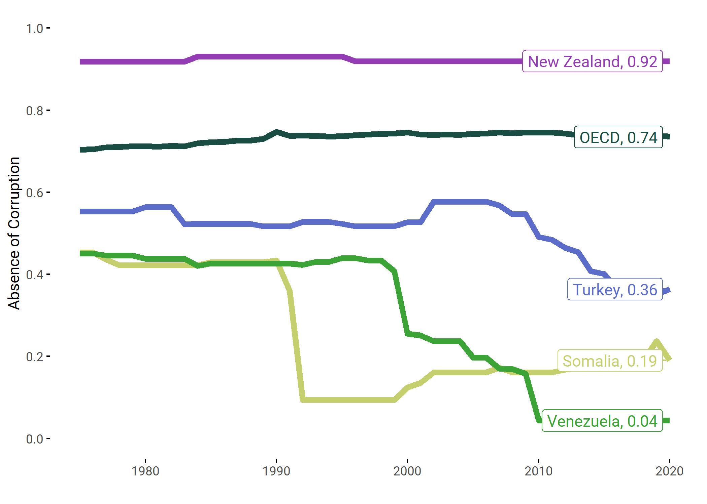
16.5 Corruption and bribery
Absence of Corruption in selected countries, 1975-2020
Notes:
popular control over-decision-making and political equality in the exercise of that control
These principles have then be translated into 5 core attributes of democracy, which are the large circles that you see, and which IDEA believes are key elements of healthy democracies:
Representative Government (which focuses on free and fair elections and free political parties), Fundamental Rights, informal and formal checks on Government, Impartial administration, which includes absence of corruption and 5) participatory engagement, which focuses on citizen participation through civil society engagement and in national and local elections
Each attribute is assigned a score from 0 to 1, with 1 being the highest performance
The indices cover 163 countries across the world from 1975 to 2019 and are updated yearly. 2020 data
Based on the indices, we have developed a political regime classification, which is new to this report
We have identified 3 broad regime types: democracies, hybrid regimes and authoritarian regimes

Slide 10
16.6 Effective, accountable and transparent institutions
2 indicators:
Indicator 16.6.1. Primary government expenditures as a proportion of original approved budget
Indicator 16.6.2 Proportion of population satisfied with their last experience of public service
1 GSoD sub attribute:
Predictable enforcement
6 indicators: the executive’s respect for constitutional provisions, the presence of transparent laws with predictable enforcement, rigorous and impartial public administration, meritocratic criteria for appointment decisions in the state administration & in the armed forces, and bureaucratic quality (bureaucratic strength and expertise).
Notes:
popular control over-decision-making and political equality in the exercise of that control
These principles have then be translated into 5 core attributes of democracy, which are the large circles that you see, and which IDEA believes are key elements of healthy democracies:
Representative Government (which focuses on free and fair elections and free political parties), Fundamental Rights, informal and formal checks on Government, Impartial administration, which includes absence of corruption and 5) participatory engagement, which focuses on citizen participation through civil society engagement and in national and local elections
Each attribute is assigned a score from 0 to 1, with 1 being the highest performance
The indices cover 163 countries across the world from 1975 to 2019 and are updated yearly. 2020 data
Based on the indices, we have developed a political regime classification, which is new to this report
We have identified 3 broad regime types: democracies, hybrid regimes and authoritarian regimes

Slide 11
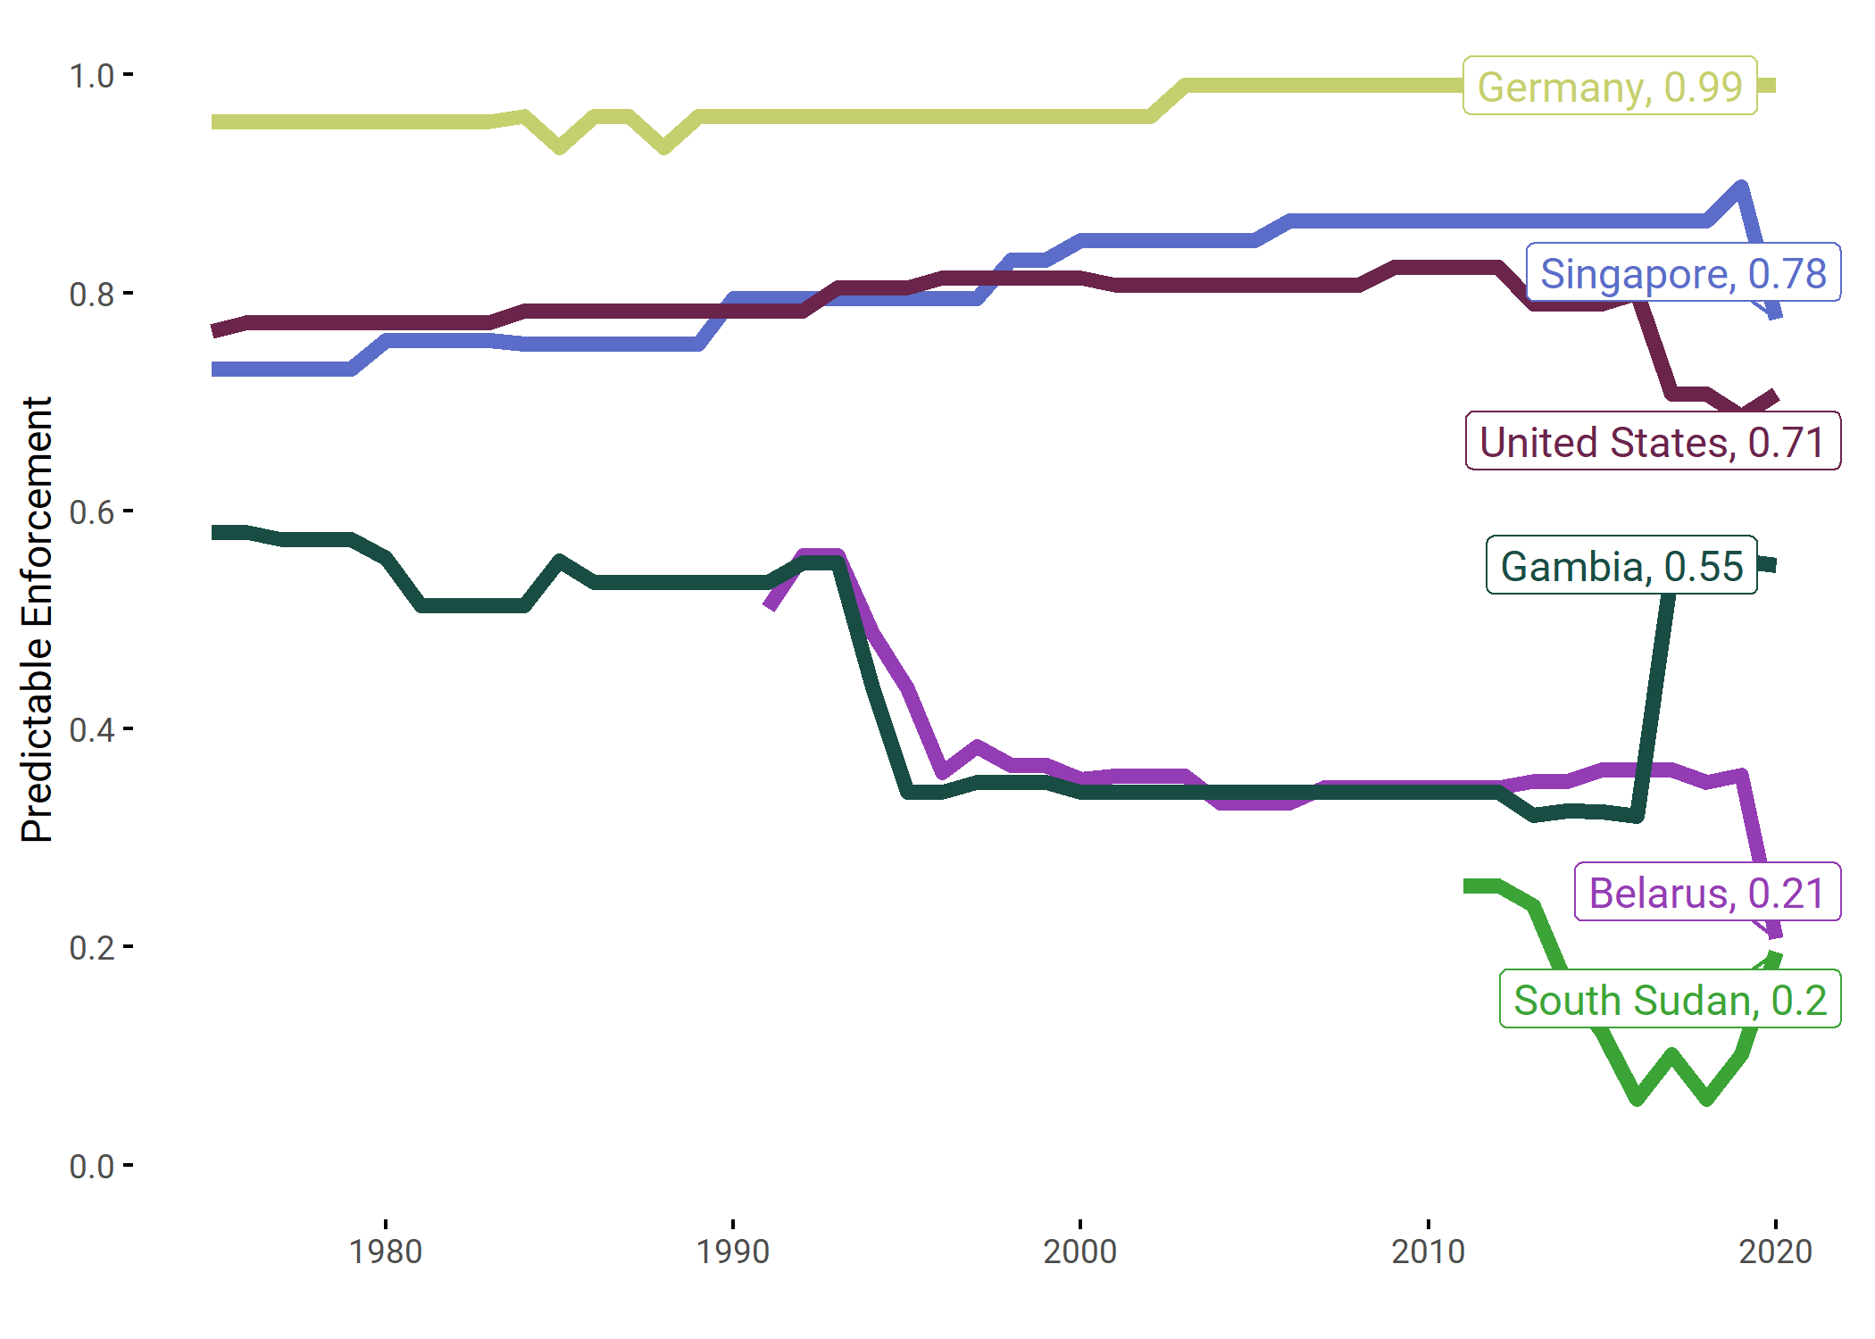
16.6 Effective, accountable and transparent institutions
Predictable Enforcement in selected countries, 1975-2020
Notes:
popular control over-decision-making and political equality in the exercise of that control
These principles have then be translated into 5 core attributes of democracy, which are the large circles that you see, and which IDEA believes are key elements of healthy democracies:
Representative Government (which focuses on free and fair elections and free political parties), Fundamental Rights, informal and formal checks on Government, Impartial administration, which includes absence of corruption and 5) participatory engagement, which focuses on citizen participation through civil society engagement and in national and local elections
Each attribute is assigned a score from 0 to 1, with 1 being the highest performance
The indices cover 163 countries across the world from 1975 to 2019 and are updated yearly. 2020 data
Based on the indices, we have developed a political regime classification, which is new to this report
We have identified 3 broad regime types: democracies, hybrid regimes and authoritarian regimes

Slide 12
16.7 Responsive, inclusive and participatory decision making
2 indicators:
Indicator 16.7.1 Proportion of positions in national and local institutions, including a)the legislatures, b) the public service and c) the judiciary, compared to national distributions, by sex, age, persons with disabilities and population groups
Indicator 16.7.2. Proportion of population who believe decision-making is inclusive and responsive, by sex, age, disability and population group
GSoD sub attribute:
Social Rights and Equality. 3 subcomponents and 24 indicators on:
  Social group equality
  Basic Welfare
  Gender Equality
Having resp, inc and participatory decision making not only about representation & satisfaction: also about the presence & quality of institutions that facilitate access and voice in politics (elections, parliaments, referenda)
Notes:
popular control over-decision-making and political equality in the exercise of that control
These principles have then be translated into 5 core attributes of democracy, which are the large circles that you see, and which IDEA believes are key elements of healthy democracies:
Representative Government (which focuses on free and fair elections and free political parties), Fundamental Rights, informal and formal checks on Government, Impartial administration, which includes absence of corruption and 5) participatory engagement, which focuses on citizen participation through civil society engagement and in national and local elections
Each attribute is assigned a score from 0 to 1, with 1 being the highest performance
The indices cover 163 countries across the world from 1975 to 2019 and are updated yearly. 2020 data
Based on the indices, we have developed a political regime classification, which is new to this report
We have identified 3 broad regime types: democracies, hybrid regimes and authoritarian regimes

Slide 13
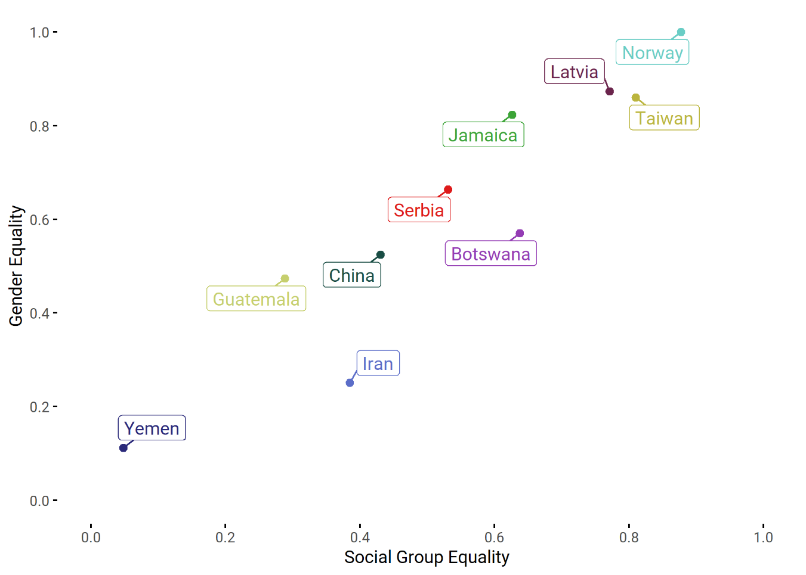
16.7 Responsive, inclusive and participatory decision making
Gender Equality and Social Group Equality in selected countries, 2020
Notes:
popular control over-decision-making and political equality in the exercise of that control
These principles have then be translated into 5 core attributes of democracy, which are the large circles that you see, and which IDEA believes are key elements of healthy democracies:
Representative Government (which focuses on free and fair elections and free political parties), Fundamental Rights, informal and formal checks on Government, Impartial administration, which includes absence of corruption and 5) participatory engagement, which focuses on citizen participation through civil society engagement and in national and local elections
Each attribute is assigned a score from 0 to 1, with 1 being the highest performance
The indices cover 163 countries across the world from 1975 to 2019 and are updated yearly. 2020 data
Based on the indices, we have developed a political regime classification, which is new to this report
We have identified 3 broad regime types: democracies, hybrid regimes and authoritarian regimes

Slide 14
Data for development (and in pandemic)
GSoD indices are a good complement to official SDG16 indicators
  High quality data from an independent institution
  Focused on democracy w/ info on specific attributes/sub attributes (116 indicators)
  Wide coverage (166 countries, 45 years)
In pandemic:
  Easily obtainable:
    Multiple sources: ES, IC, OD, CM.
    Gathered from a wide range of reputable and available sources (12…V-DEM, ICRG, UN data)
  IDEA was able to collect data in 2020 and delivered update (v.5) on time
Notes:
popular control over-decision-making and political equality in the exercise of that control
These principles have then be translated into 5 core attributes of democracy, which are the large circles that you see, and which IDEA believes are key elements of healthy democracies:
Representative Government (which focuses on free and fair elections and free political parties), Fundamental Rights, informal and formal checks on Government, Impartial administration, which includes absence of corruption and 5) participatory engagement, which focuses on citizen participation through civil society engagement and in national and local elections
Each attribute is assigned a score from 0 to 1, with 1 being the highest performance
The indices cover 163 countries across the world from 1975 to 2019 and are updated yearly. 2020 data
Based on the indices, we have developed a political regime classification, which is new to this report
We have identified 3 broad regime types: democracies, hybrid regimes and authoritarian regimes

Slide 15

Thank you!
@int_IDEA
@malaraotaola

